Slide 1

UMAMe is a platform that allows individuals to post and recreate recipes posted by their peers. It is an inclusive and diverse platform that aims to empowers creators to not only share their recipes, but express themselves through their cooking. It fosters a positive environment by inviting creator with all different cooking styles.

Slide 2

What we offer
Key Features
Recipe Home - feed
Recipe Search
Ingredient Mixer
Cooking Mode
Recipe Collection
Difficulty Bar
Add Recipe

Slide 3
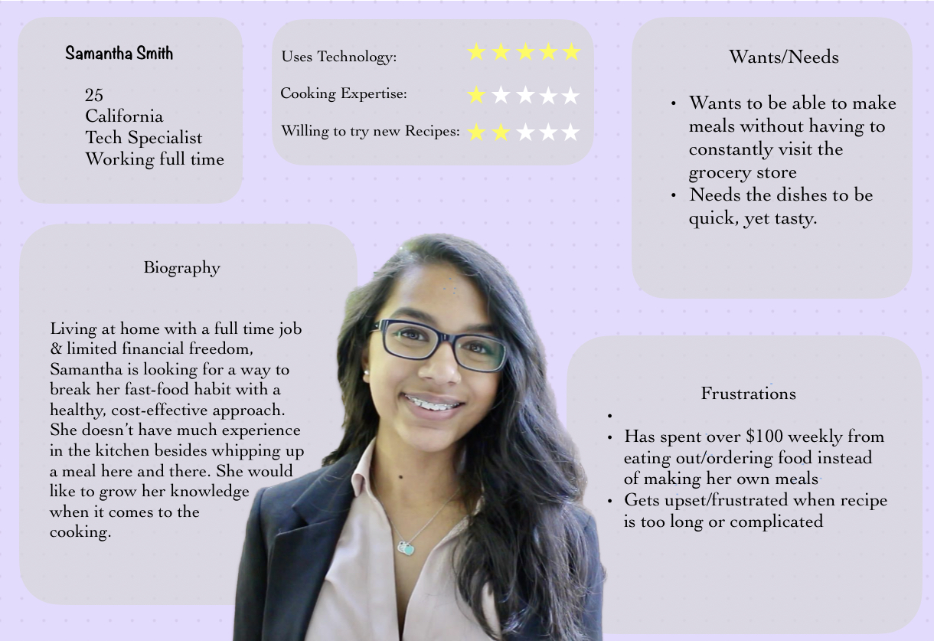
Usefulness
For a software to be useful, it must meet the needs and expectations of its consumers.
Understanding the pain points of customers
Using what we learned in M2 to address customer pain points (conducted in-person surveys)
Take a look at Sam’s pain point: constantly having to visit the grocery store
Our ingredient mixer address that pain point.
Notes:
Usable
Is it easy to use?
Enabling users to effectively and efficiently achieve their end goal
Requiring less cognitive load

Slide 4
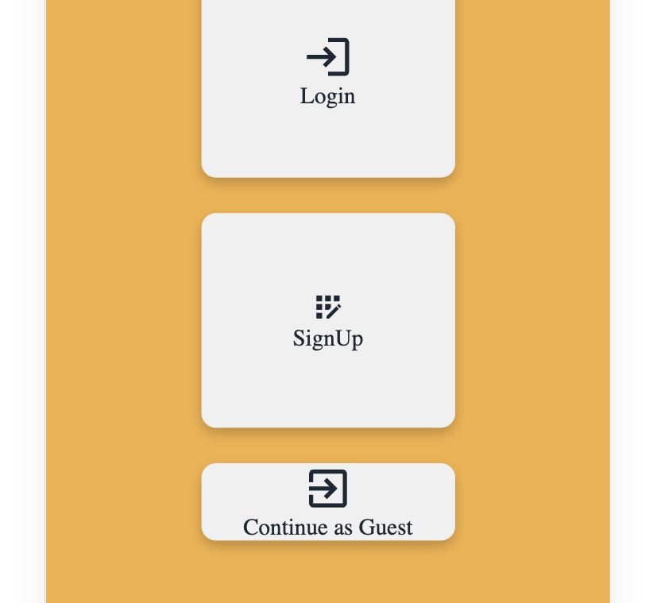
Usability
To cover the wants of majority, our app has a Guest login, where all the recipes are visible in the homepage. This will address the issue, where our users just want to surf over internet to find quality recipes. Our app will convince them to create accounts after the appealing content and easy accessibility. That is our goal.
Notes:
Useful
Does the function work?
Does this product provide a meaningful function?

Slide 5
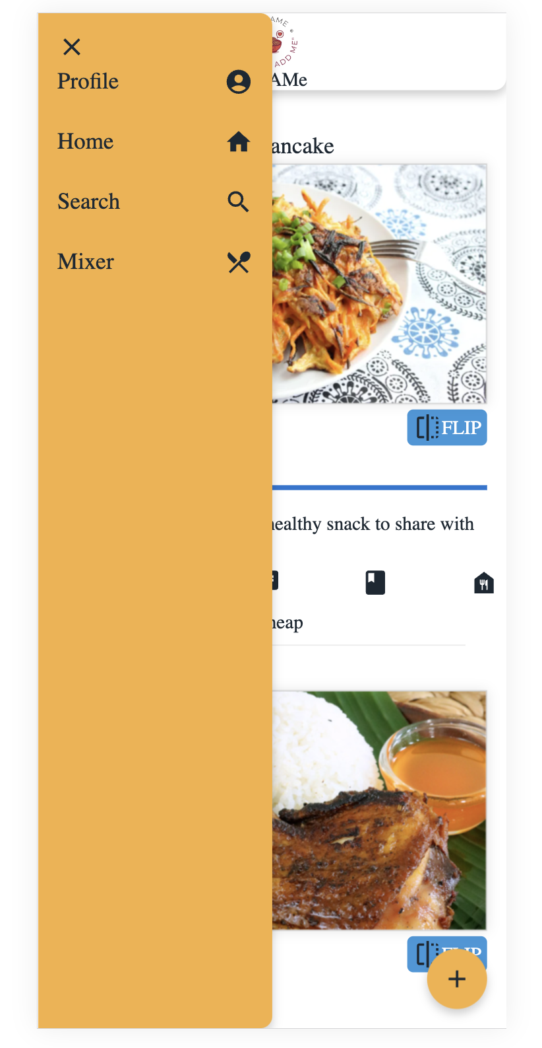
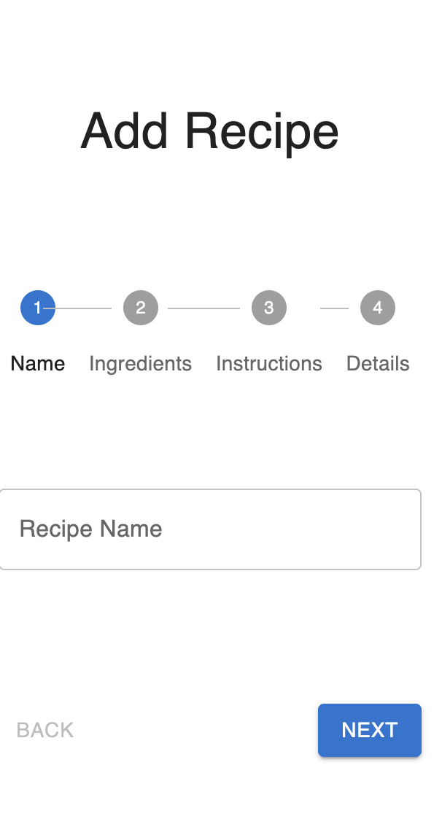
Usability
UMAMe provides ease with navigation. With a navigation bar located at the bottom, the search bar located at the top, UMAMe provides a sense of familiarity to other common applications
Doesn’t require cognitive load
Consistency: nav bar always located at bottom, each card has the same layout: image, comments, description.
Progressive Disclosure: having too many inputs fields simultaneously can be overwhelming for a user. This is why we broke down our “add post” feature. That way, users are aware of the next field, yet not overwhelmed with too many fields.
Notes:
Useful
Does the function work?
Does this product provide a meaningful function?

Slide 6
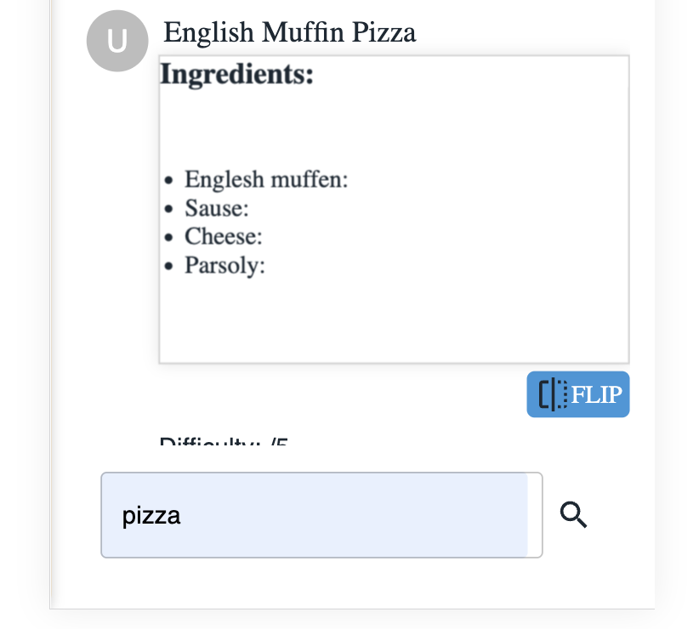
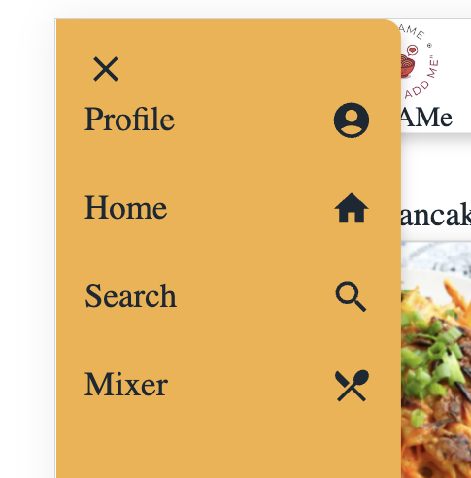
Findability
Users are reluctant to read instructions
How do we address this? A simple search option allows users to find what
they need, quickly.
Visual Cues: Humans prefer not to read. Using icons adds visual aspect.
Notes:
Findable
Easy to locate specific objects to perform a function
Users are reluctant to read instructions

Slide 7
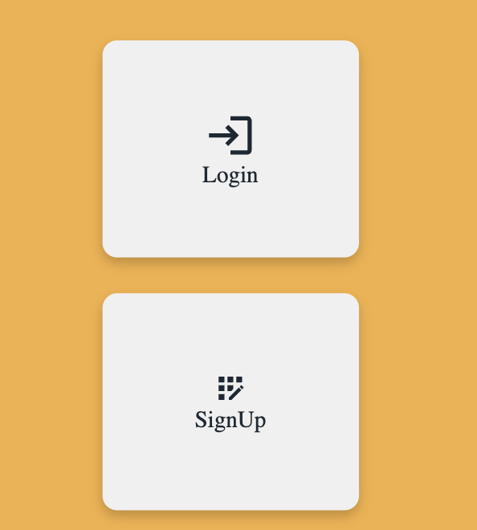
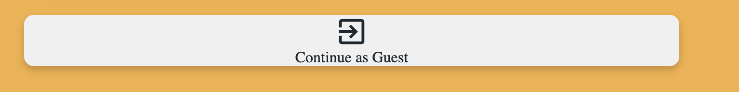
Credibility
Building credibility is essential for gaining trust of users
This is exactly why we introduced guest mode
We want users to feel confident when they sign up with UMAMe. By having a guest mode, users get a sneak peak of what our software is like.
We don’t want them to feel anxious about signing up with a new software.
Notes:
Credible
Ability for users to trust (or not trust) in the product

Slide 8
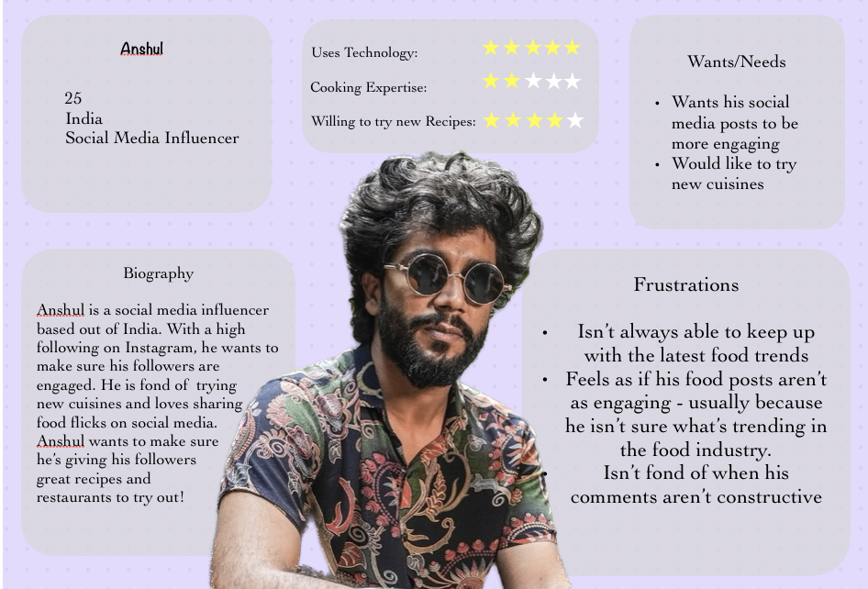
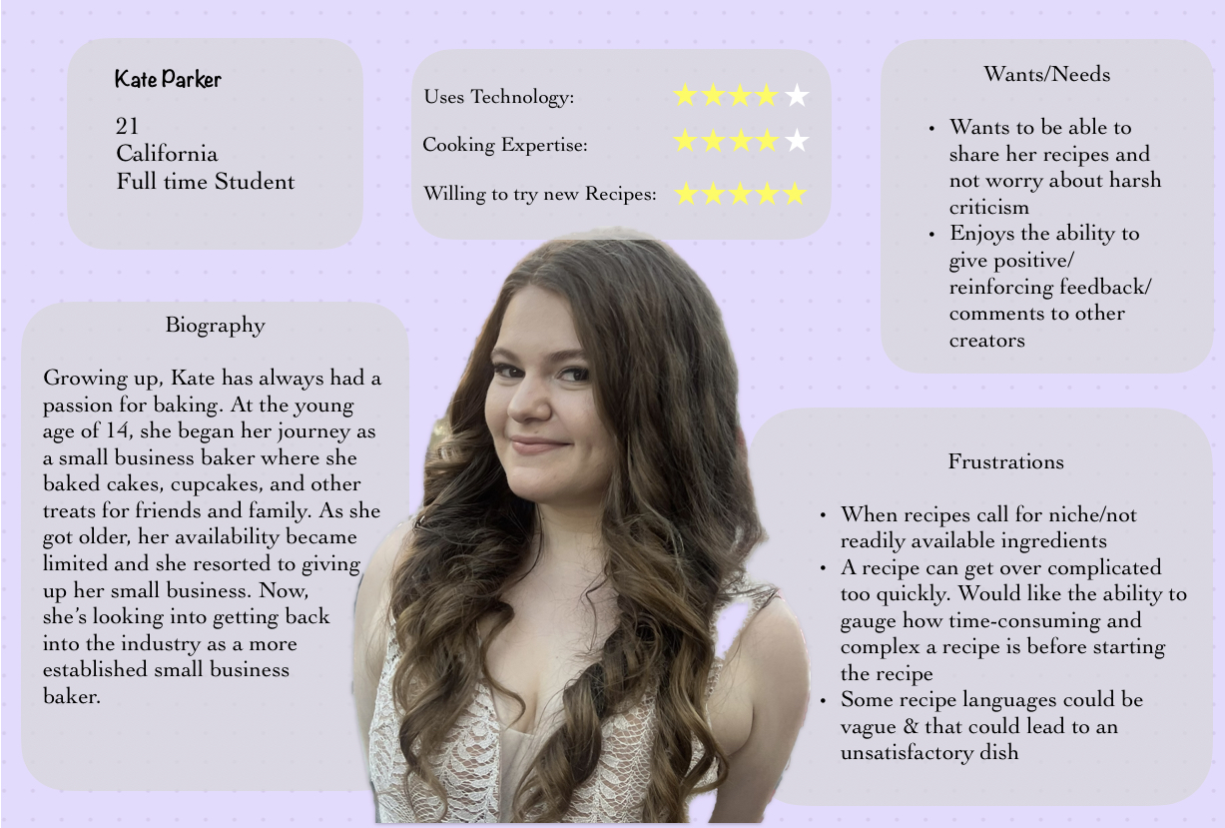
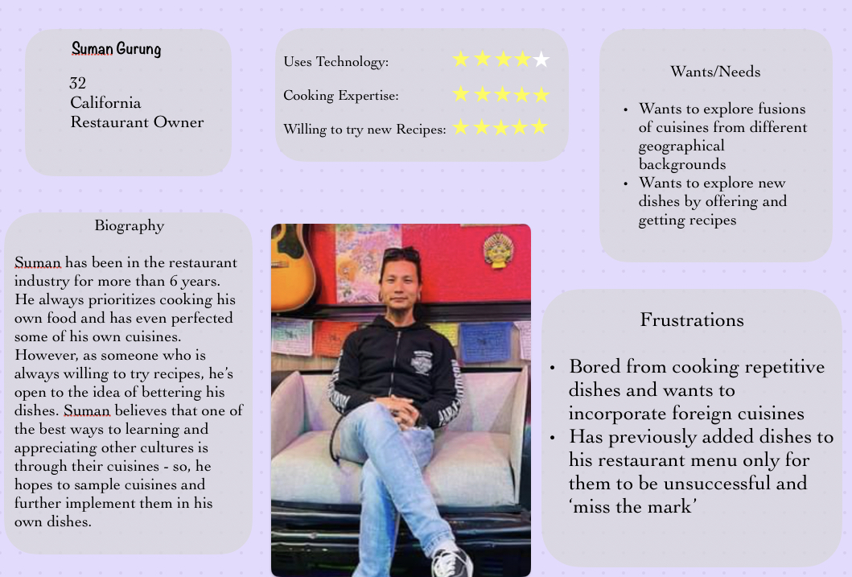
Desirability
Creating a desirable software product involves making it not just functional but also enjoyable and appeal to users.
We wanted a user-centric design
By creating user personas that address all needs/pain points from a wide range of potential users, we are able to create UMAMe to be more enjoyable.
Our ingredient mixer addresses a very common pain point: being about to create dishes based on the ingredients already present in your kitchen,
Notes:
Desirable
How pleasant to use?
About impression

Slide 9
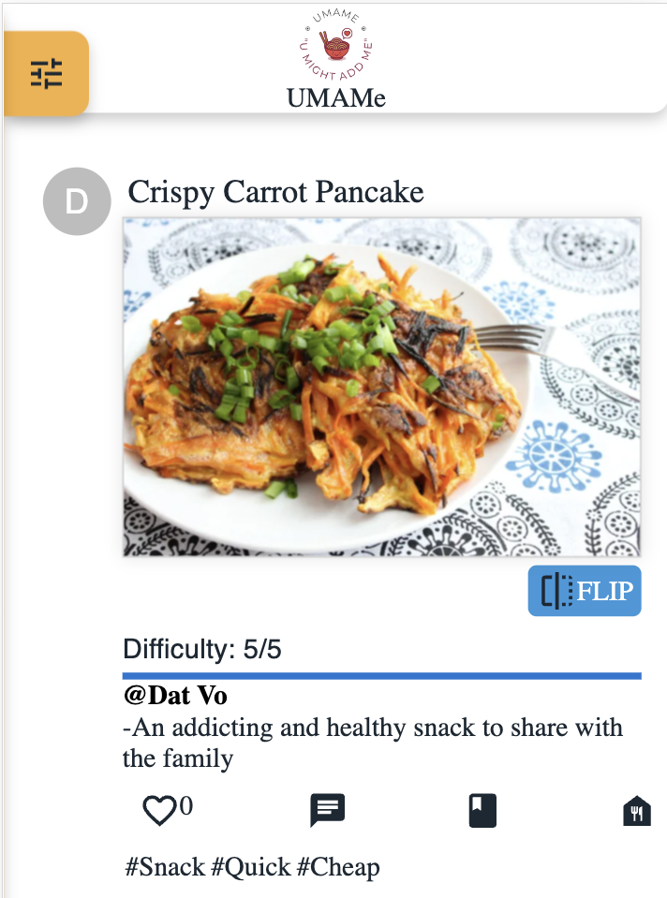
Accessibility
Creating an accessible software product involves designing an inclusive user experience that accommodates individuals with varying abilities and preferences
Screen Compatibility: While creating UMAMe, we wanted to ensure our software will be compatible on different types of devices. This is why we focused on UX design on both desktops/computers and mobile devices
Additionally, using labels and icons allows us to convey information in various ways (i.e.) although our navigation bar has icons, when hovering over the icon, text appears
Notes:
Accessible
For people who interact with product differently
Providing an experience which can be access by users of a full range of abilities

Slide 10
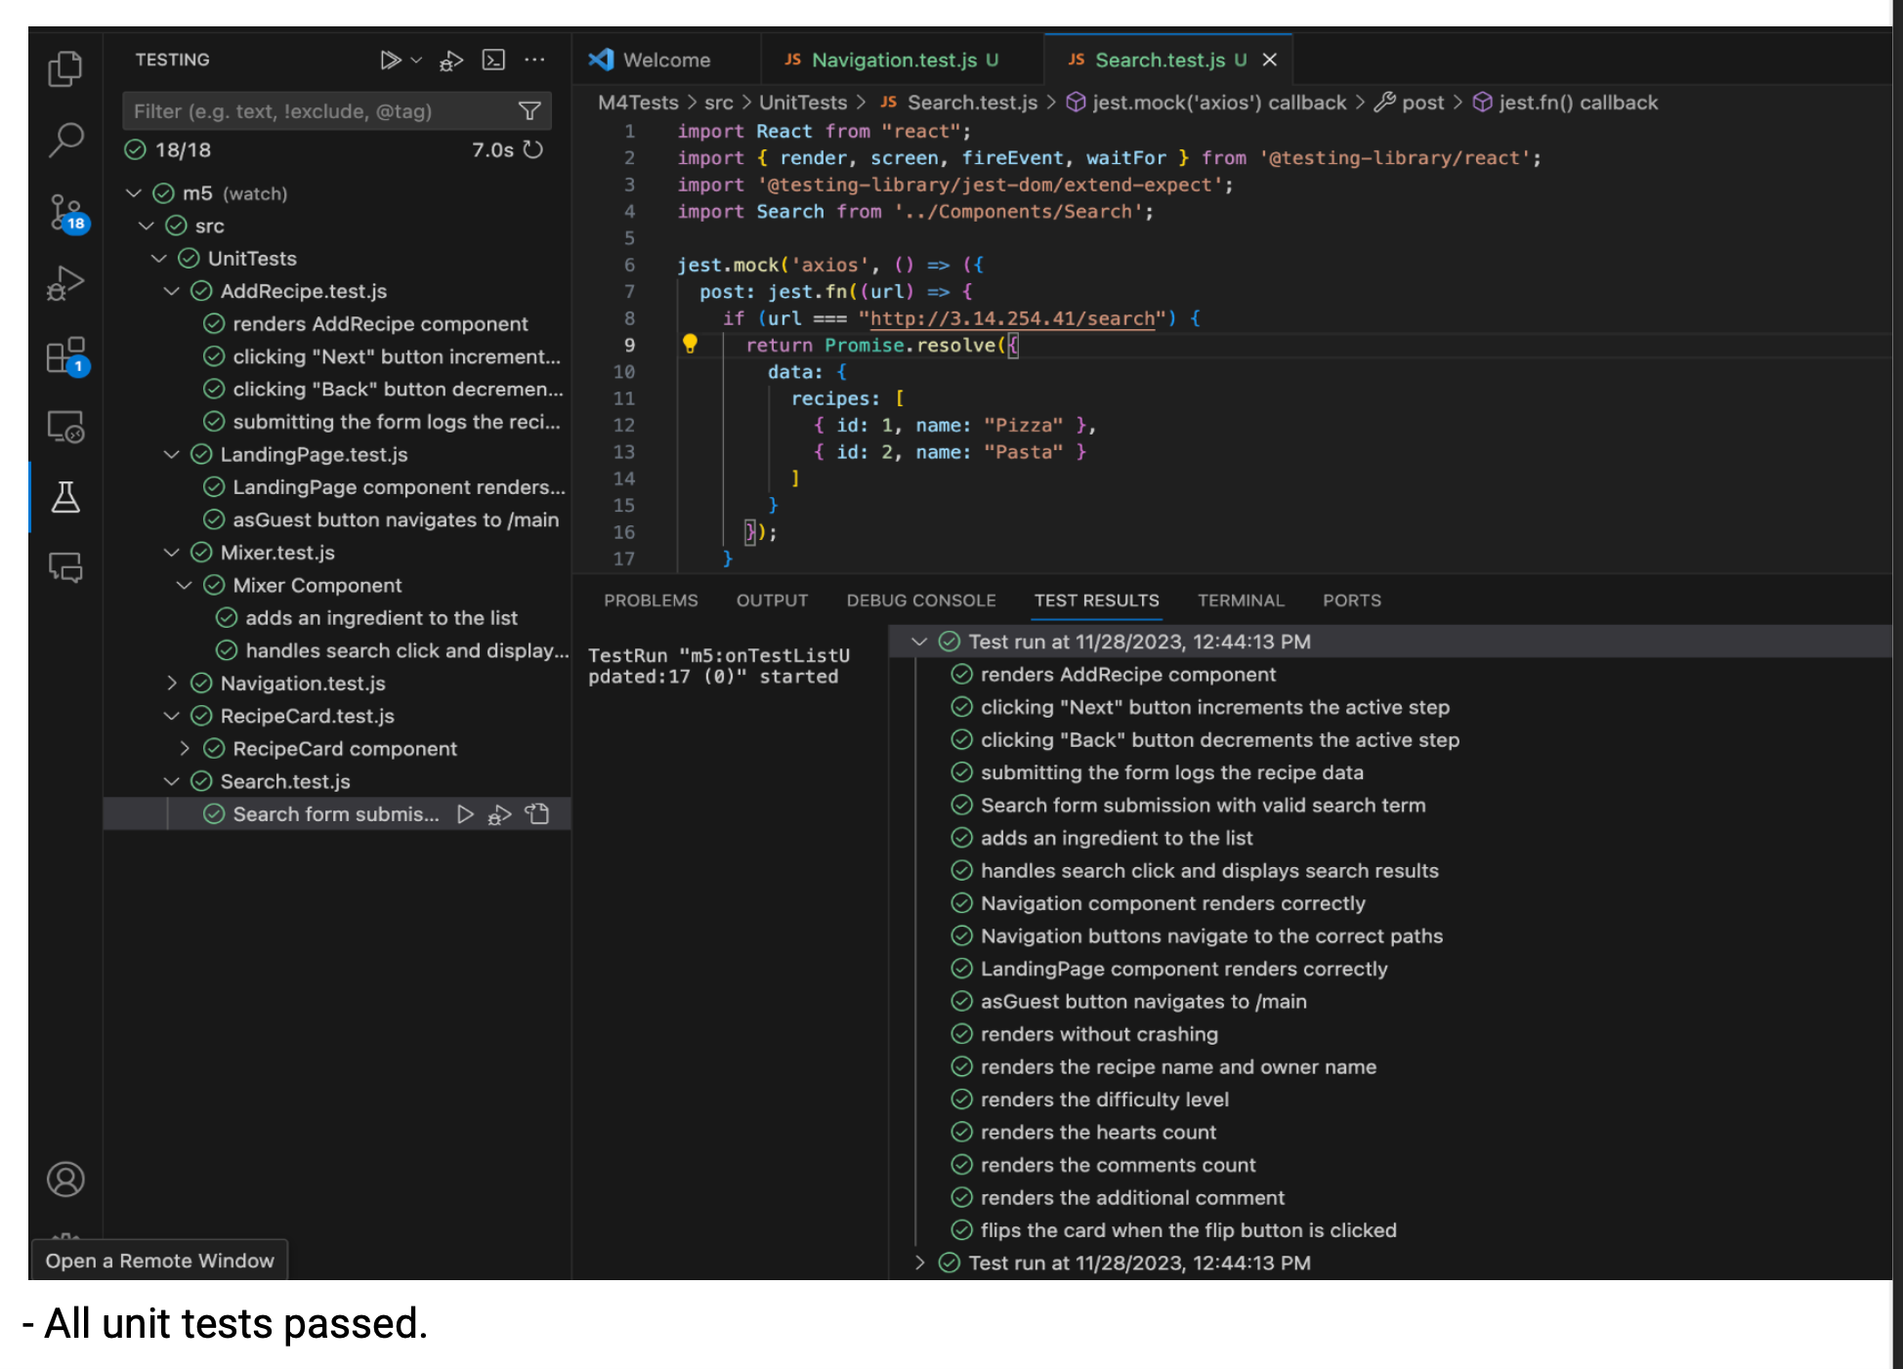
Everything tested
We tested everything before putting them up on the server to make sure that our users do no face any inconvenience while using our app.
All the components are tested individually with no room for error in the making. We are confident that we would be responsible for such errors to gain our users’ trust.

Slide 11

UMAMe
The making …

Slide 12
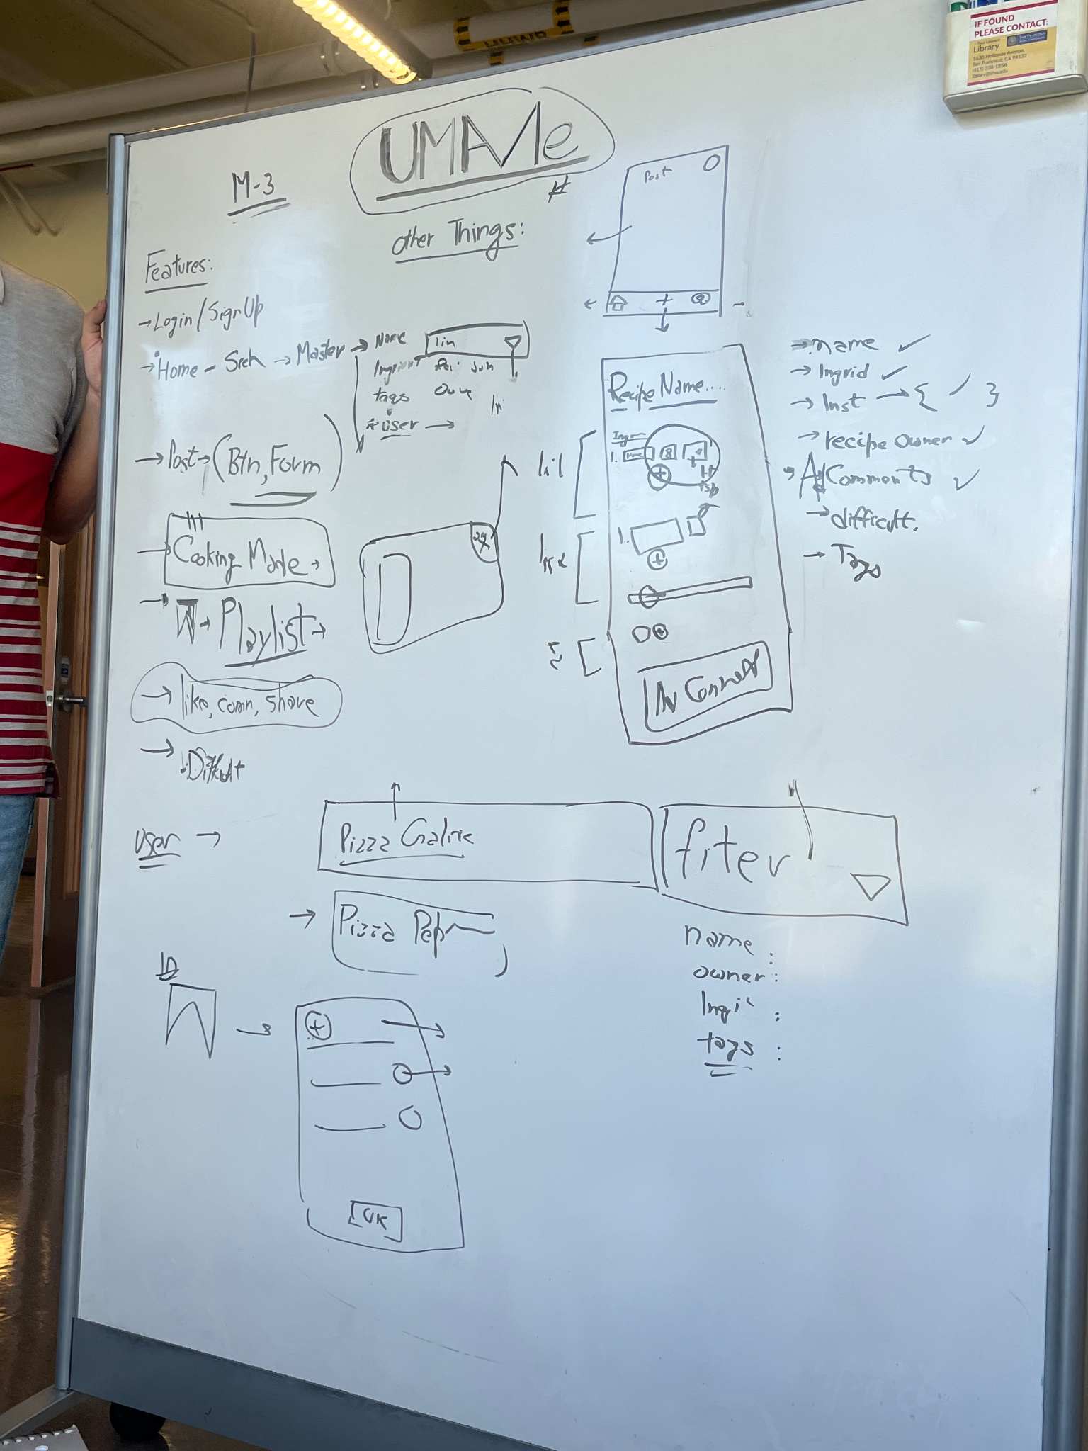
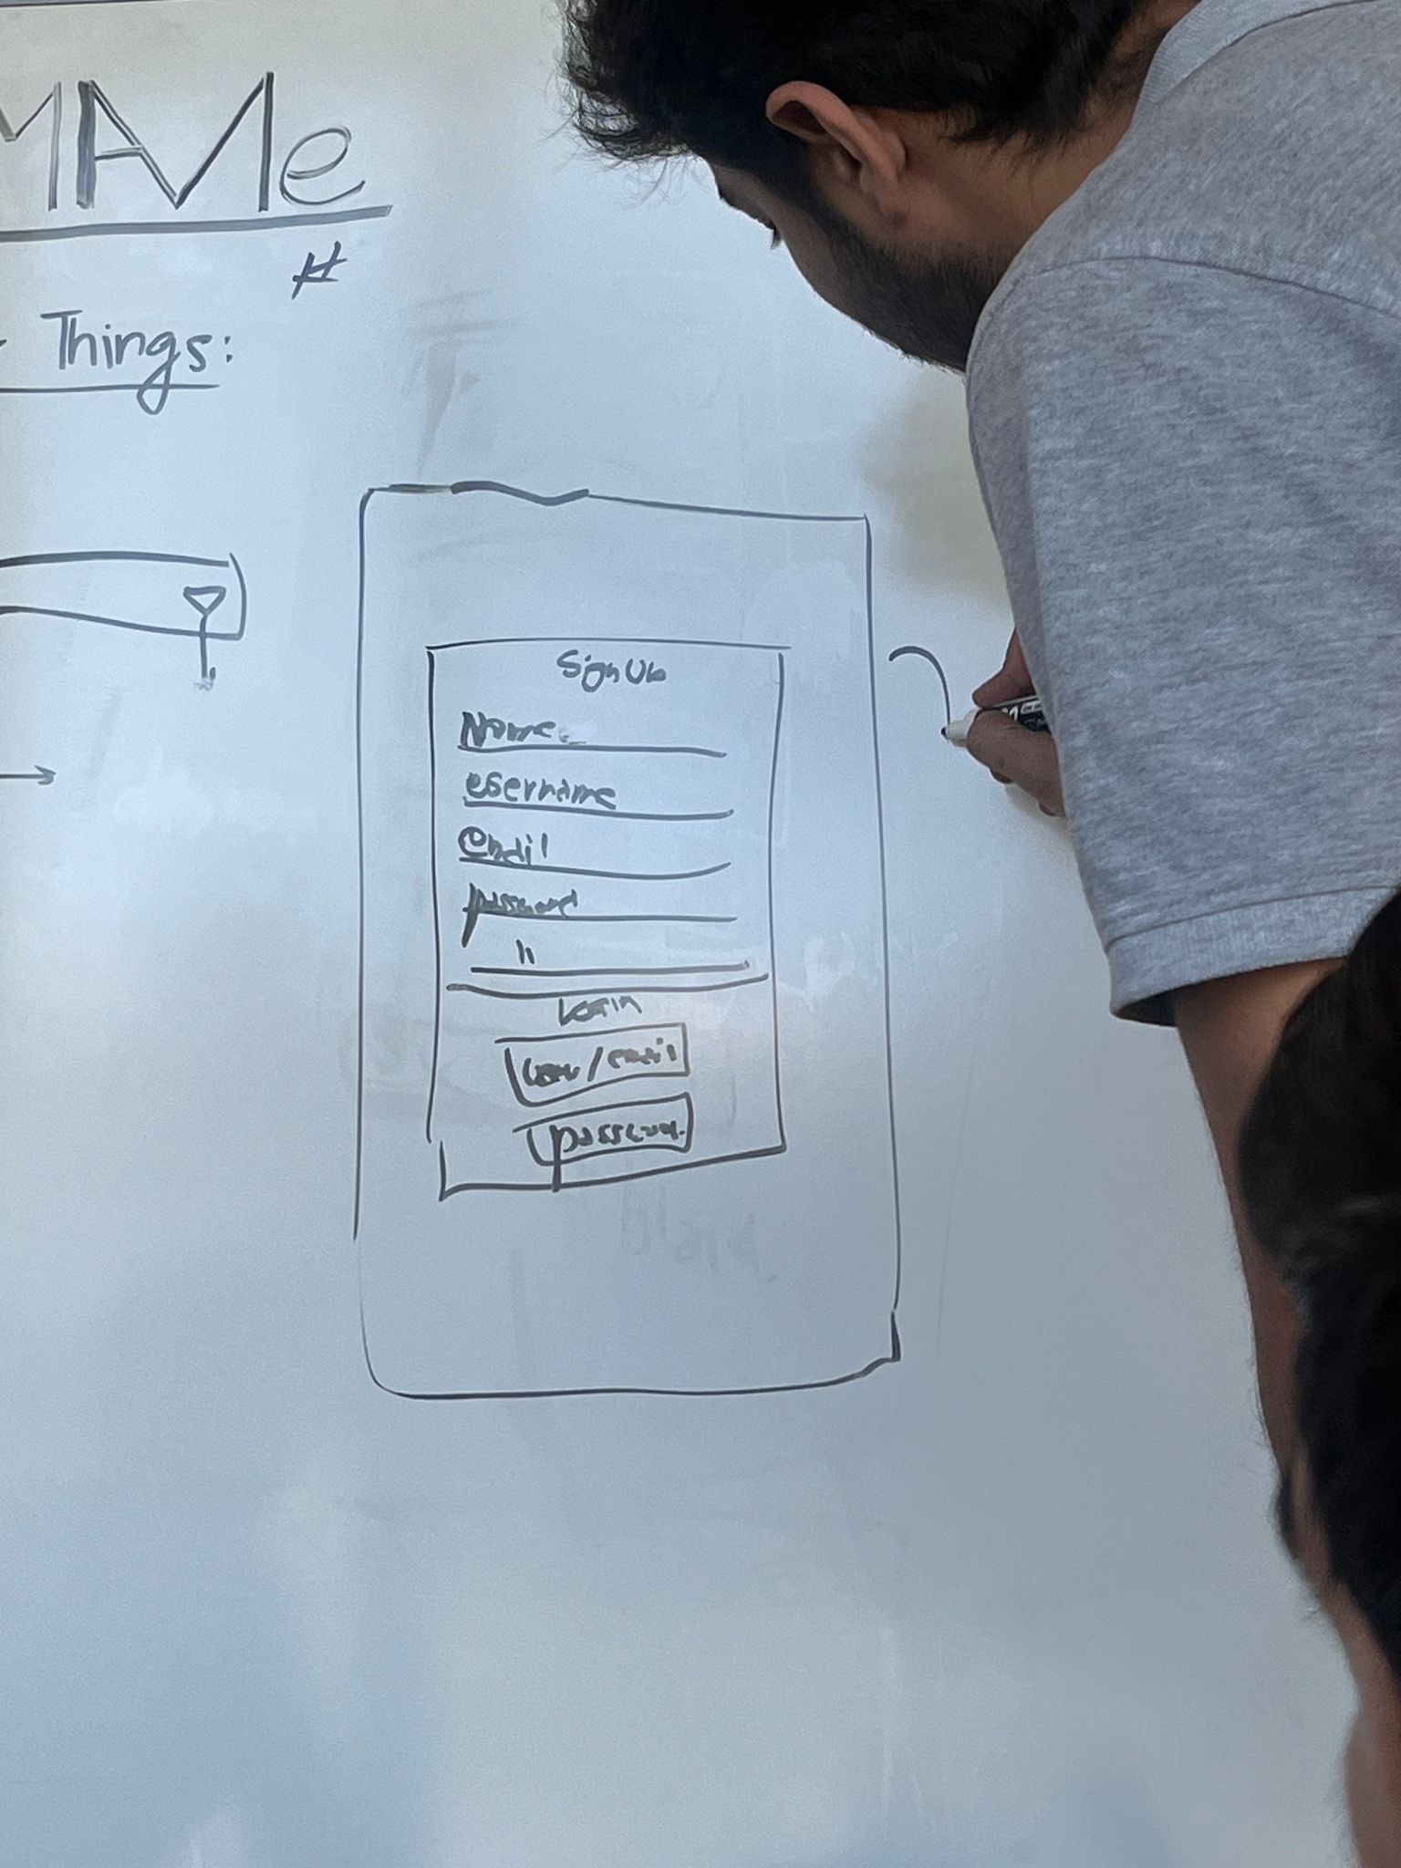

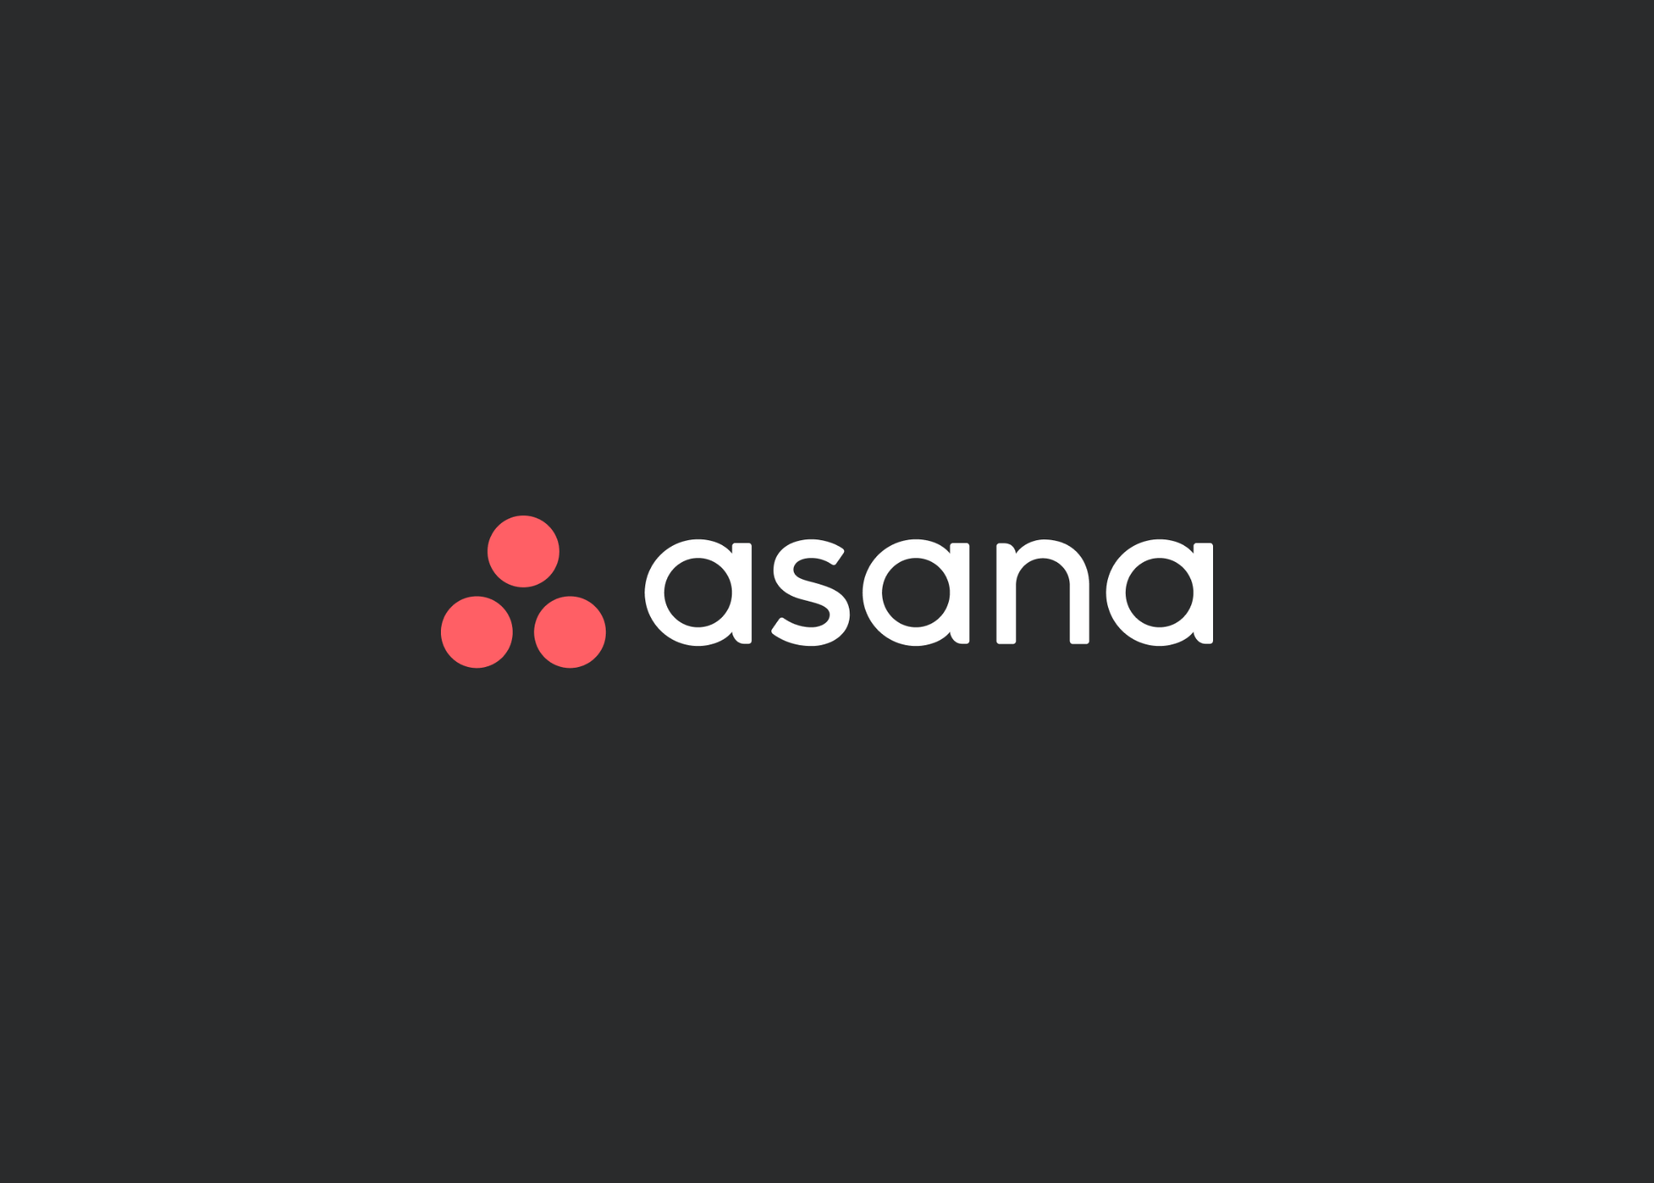

Meeting Setup
IN-PERSON MEETINGS
MONDAY 11:00 AM-12:30 PM / WEDNESDAY MEETING 2:00 PM -3:00 PM
VIRTUAL MEETINGS
Notes:
We all have different schedules, so we set up a meeting system that allows each member to at least attend one meeting per week

Slide 13
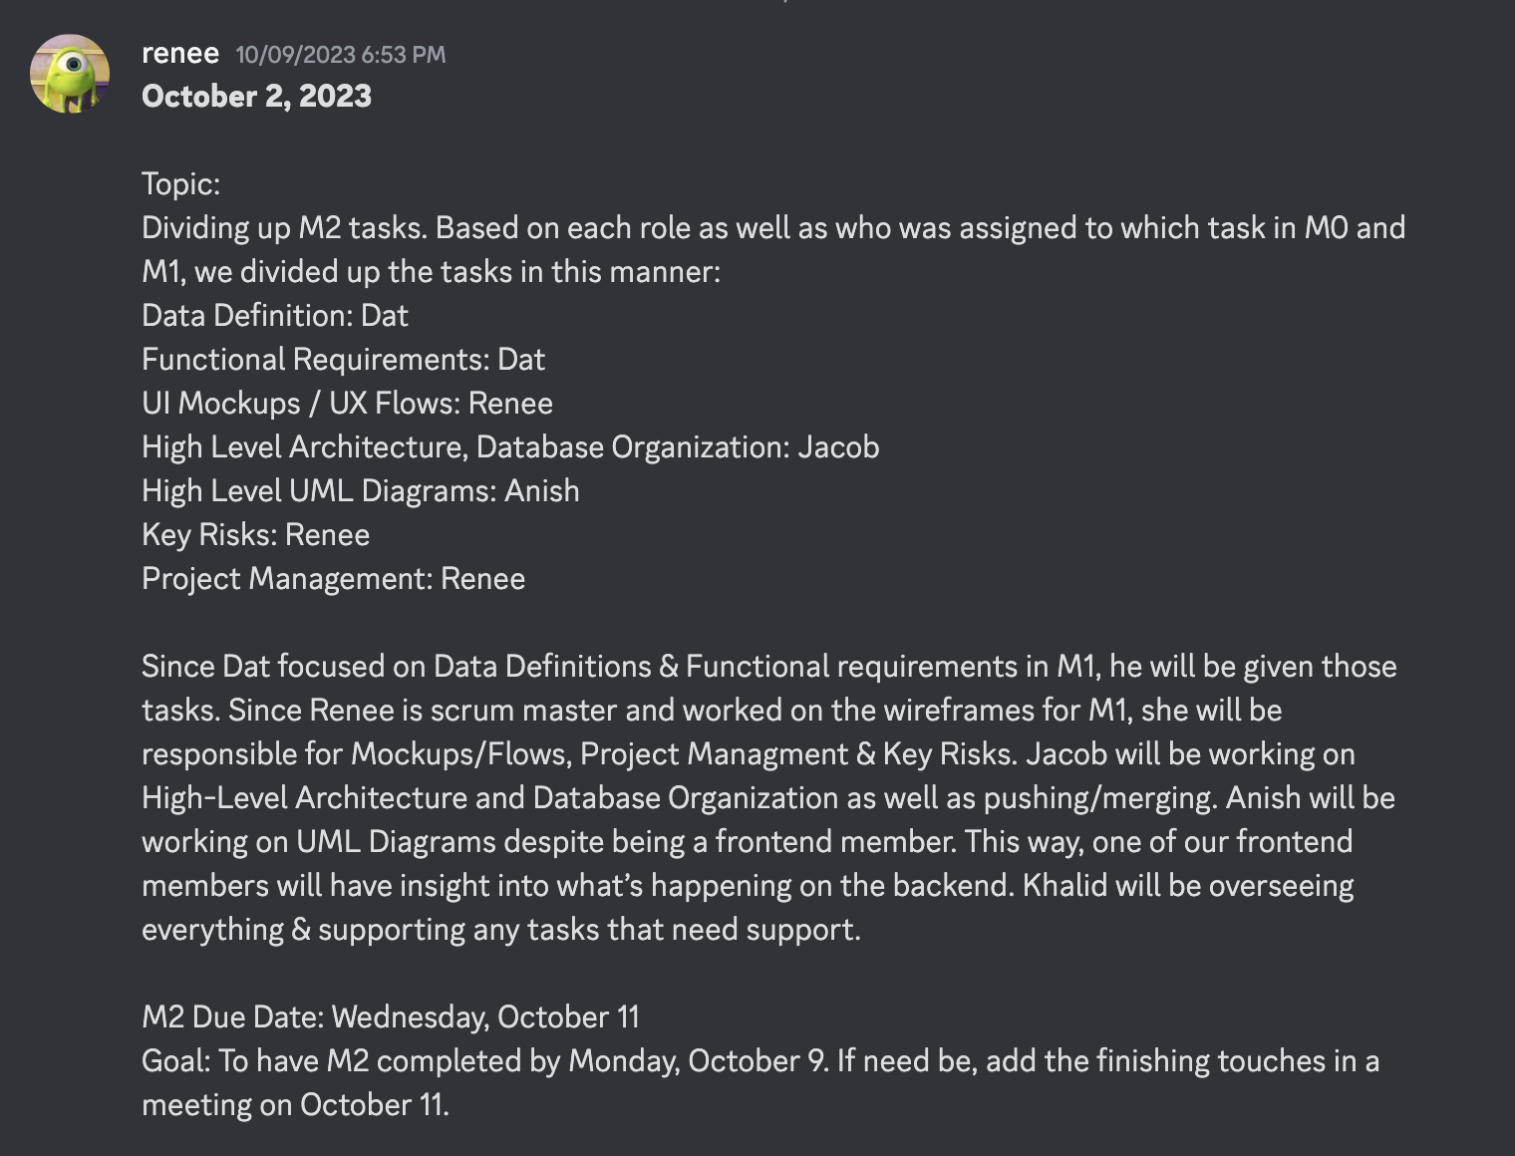
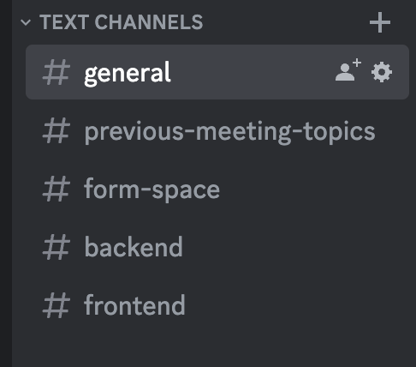
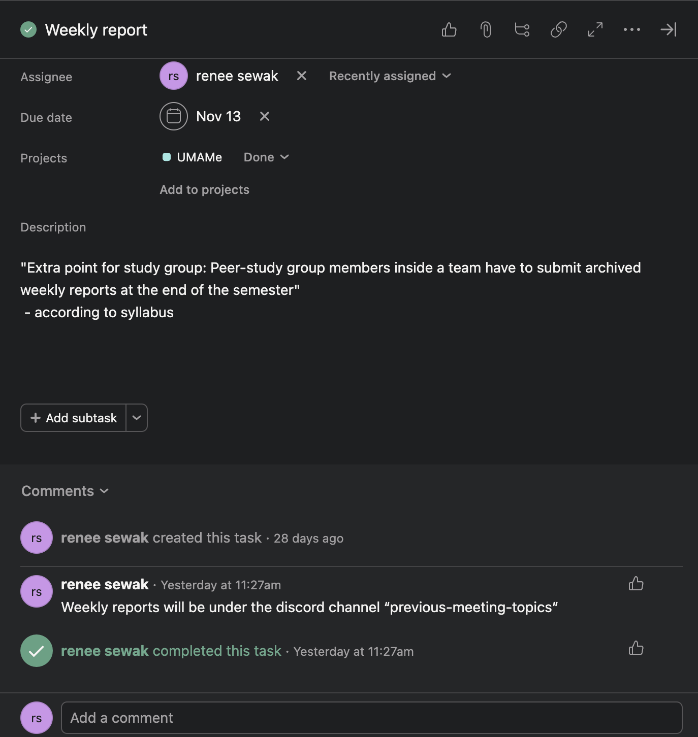
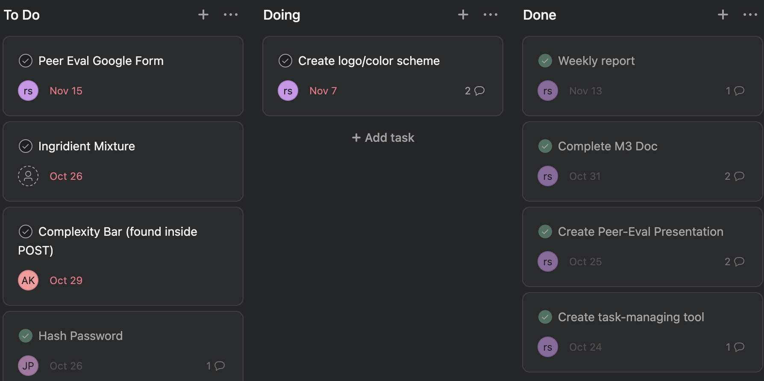
DISCORD CHANNELS
“PREVIOUS-MEETING-TOPIC”
ASANA (TASK MANAGEMENT)
ASANA TASK EXAMPLE
Notes:
Task management (main channels of communication)
Discord
Asana

Slide 14
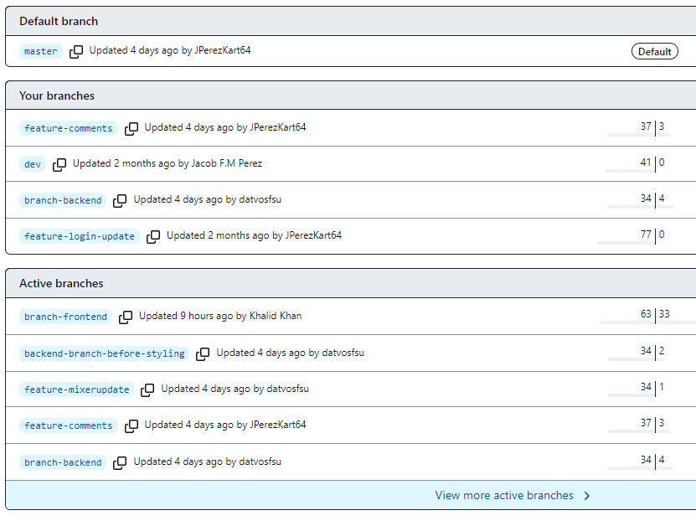
Source Code Management
GitHub:
Branches
We had established a dev branch for the first few Milestones
All the big changes we wanted to test would be here
While this was helpful, we focused our efforts on separate front and back end branches
Some time down the road, we settled on making separate branches for Front-end and Back-end
This way we could reduce the file size for local repos
Notes:
Talk about GitHub

Slide 15
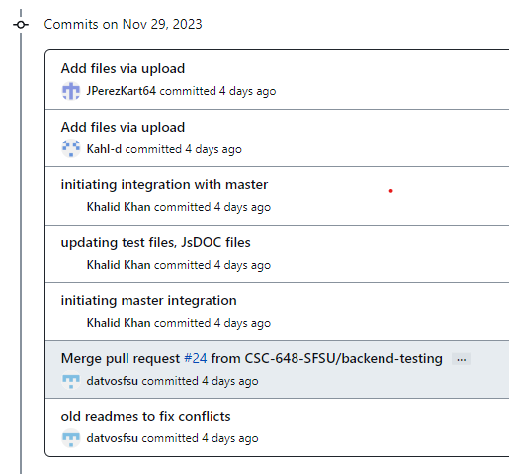
Source Code Management
GitHub:
Commits (pictured: master branch)
Usually small features that either exist on their own or build to a whole
Here were some of the last few commit we made before M4
Not much in the way of detailed changes
Not much instances where changes needed to be rolled back

Slide 16
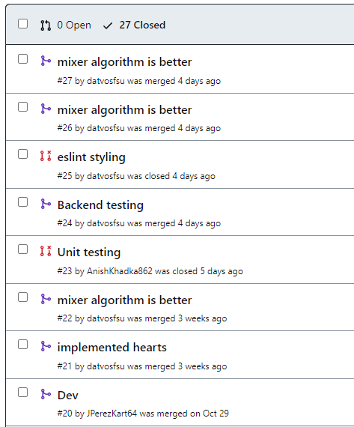
Source Code Management
GitHub:
Pull Requests
We kept the feature branches up after we merged them with the dev branch.
This was kept mostly for archival purposes and to track our features
We faced merge conflicts a few times
These emerged from deleting the contents of previous Milestones to reduce file size for future builds
Master branch was unaffected
Code Review
Our front and back end leads were the ones in charge of review
Everyone else could leave feedback, but leads had final verdict

Slide 17
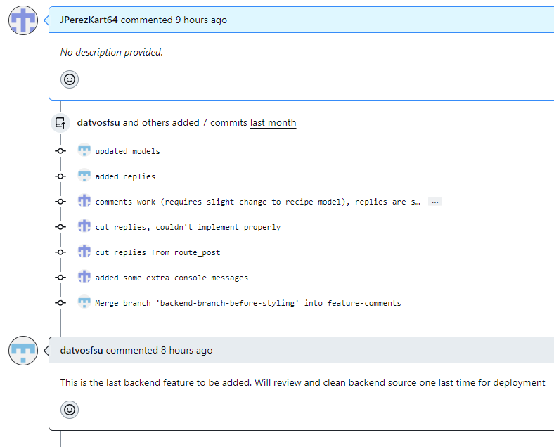
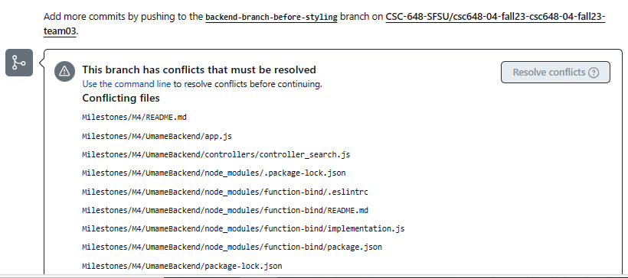
Source Code Management
(Some extra screenshots of our git repo)
Left is commit history for pull request
Below are some conflicts we faced before merging

Slide 18
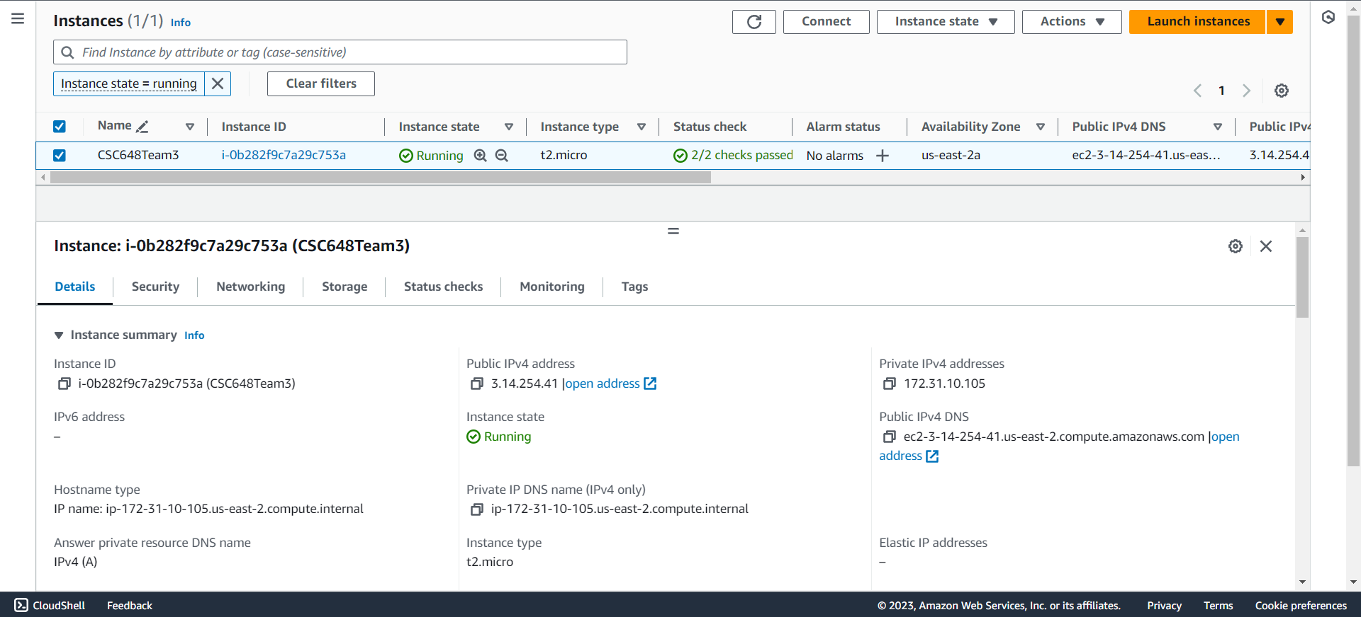
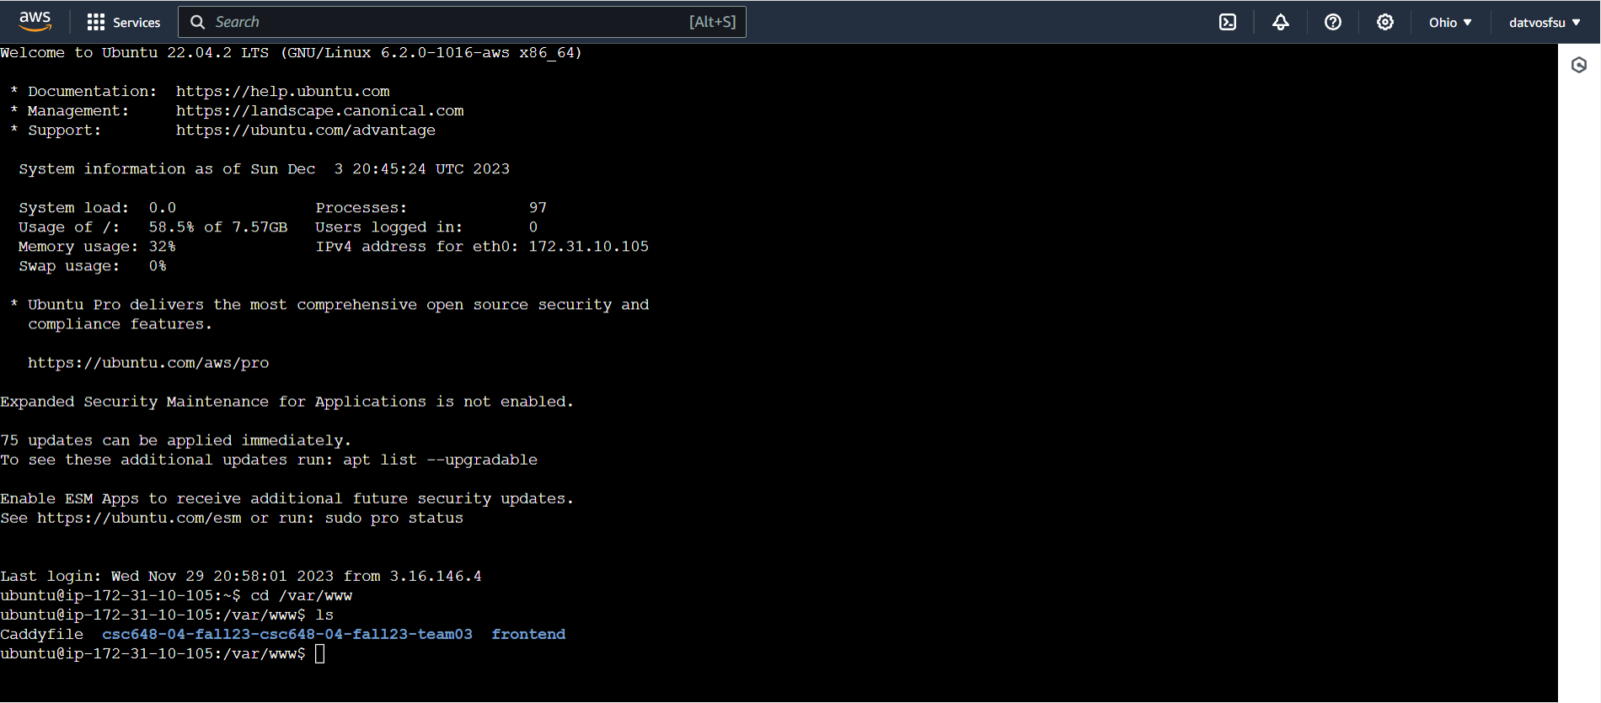
Remote Server with Amazon EC2

Slide 19
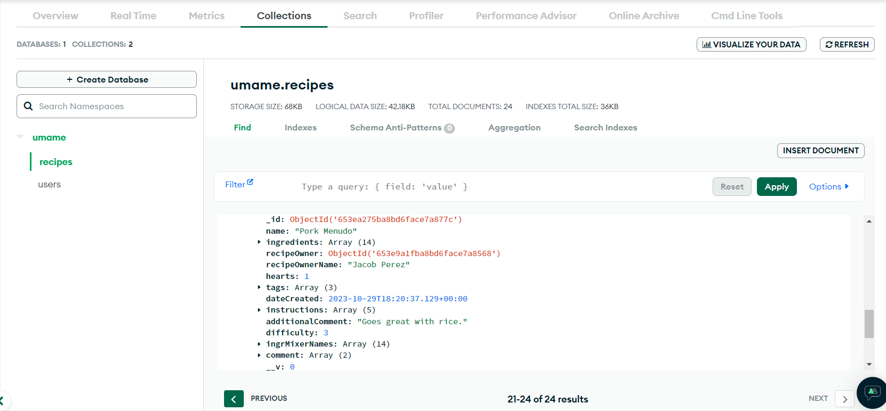
MongoDB Atlas
Notes:
“Why our UX” is good in terms of usability,

Slide 20
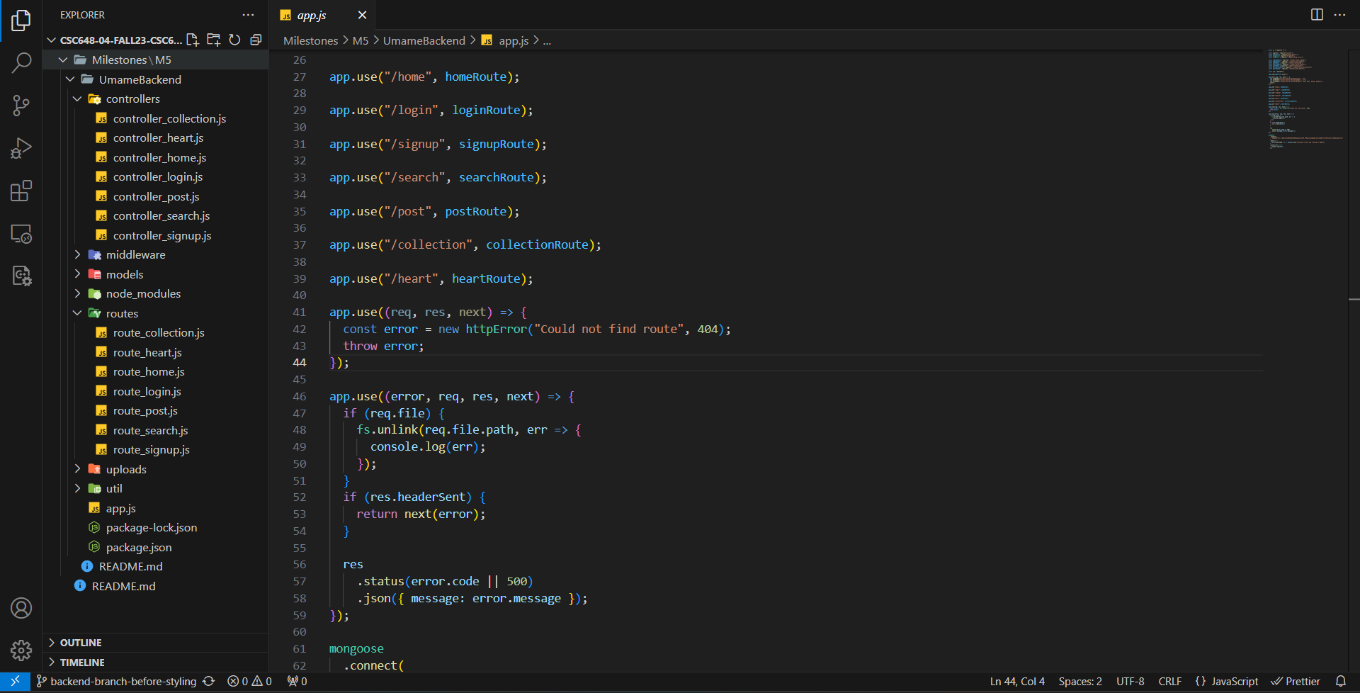
Backend Source Code
Notes:
“Why our UX” is good in terms of usability,

Slide 21
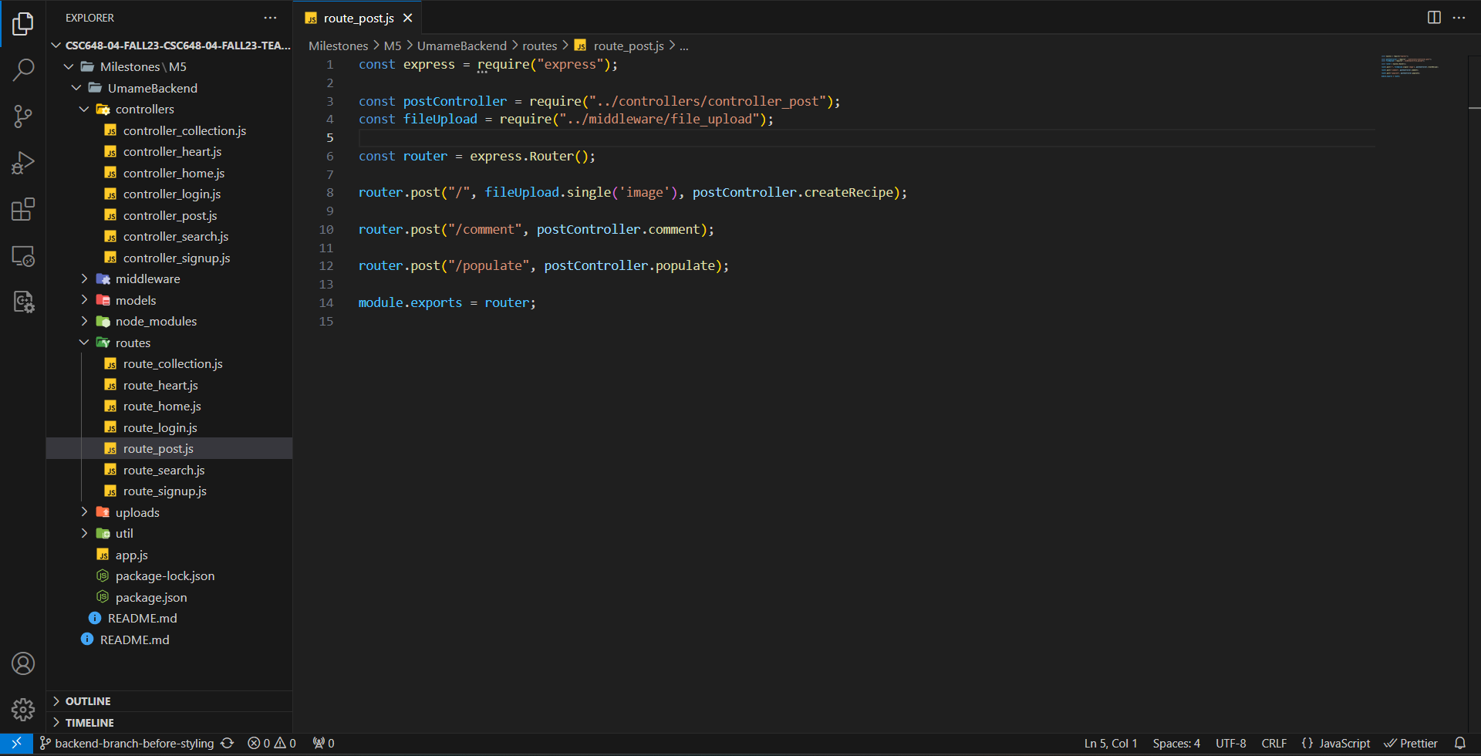
Backend Source Code
Notes:
“Why our UX” is good in terms of usability,

Slide 22
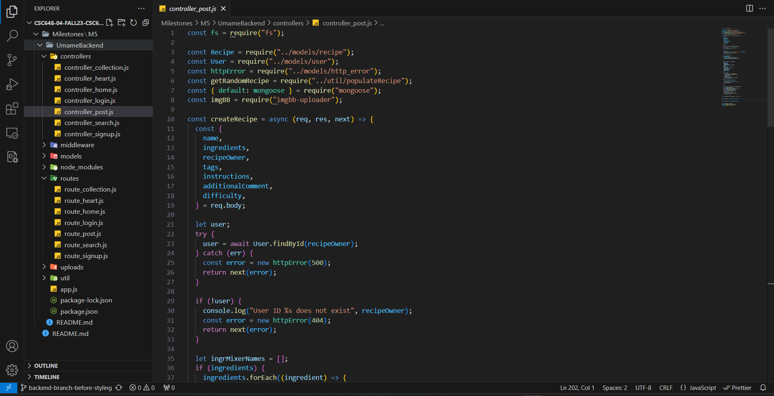
Backend Source Code
Notes:
“Why our UX” is good in terms of usability,

Slide 23
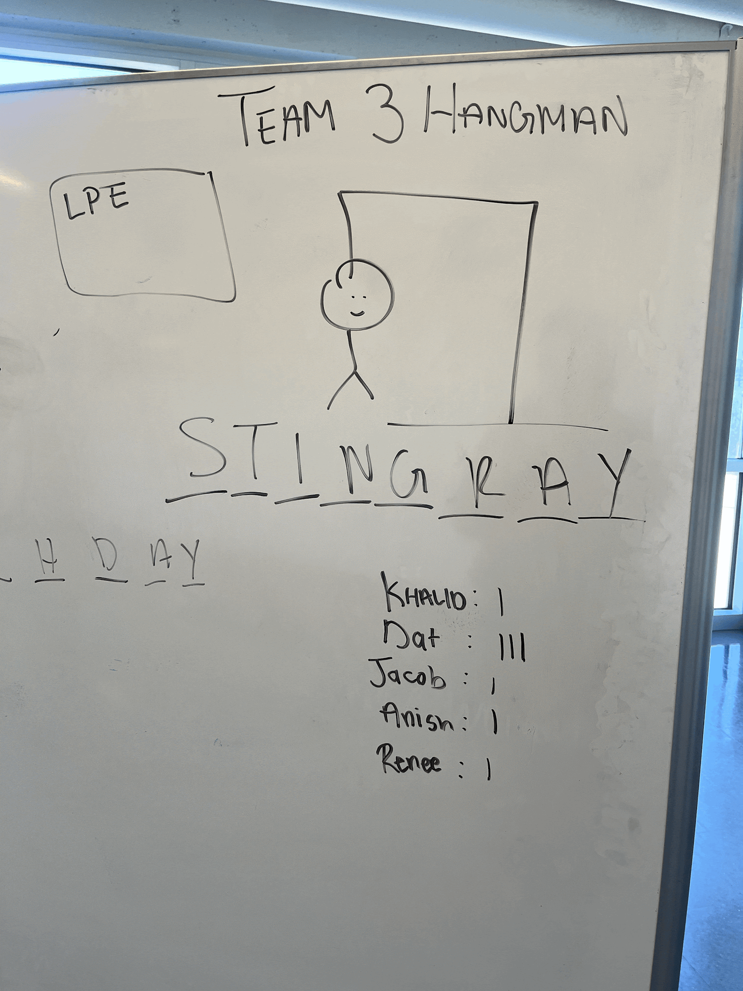
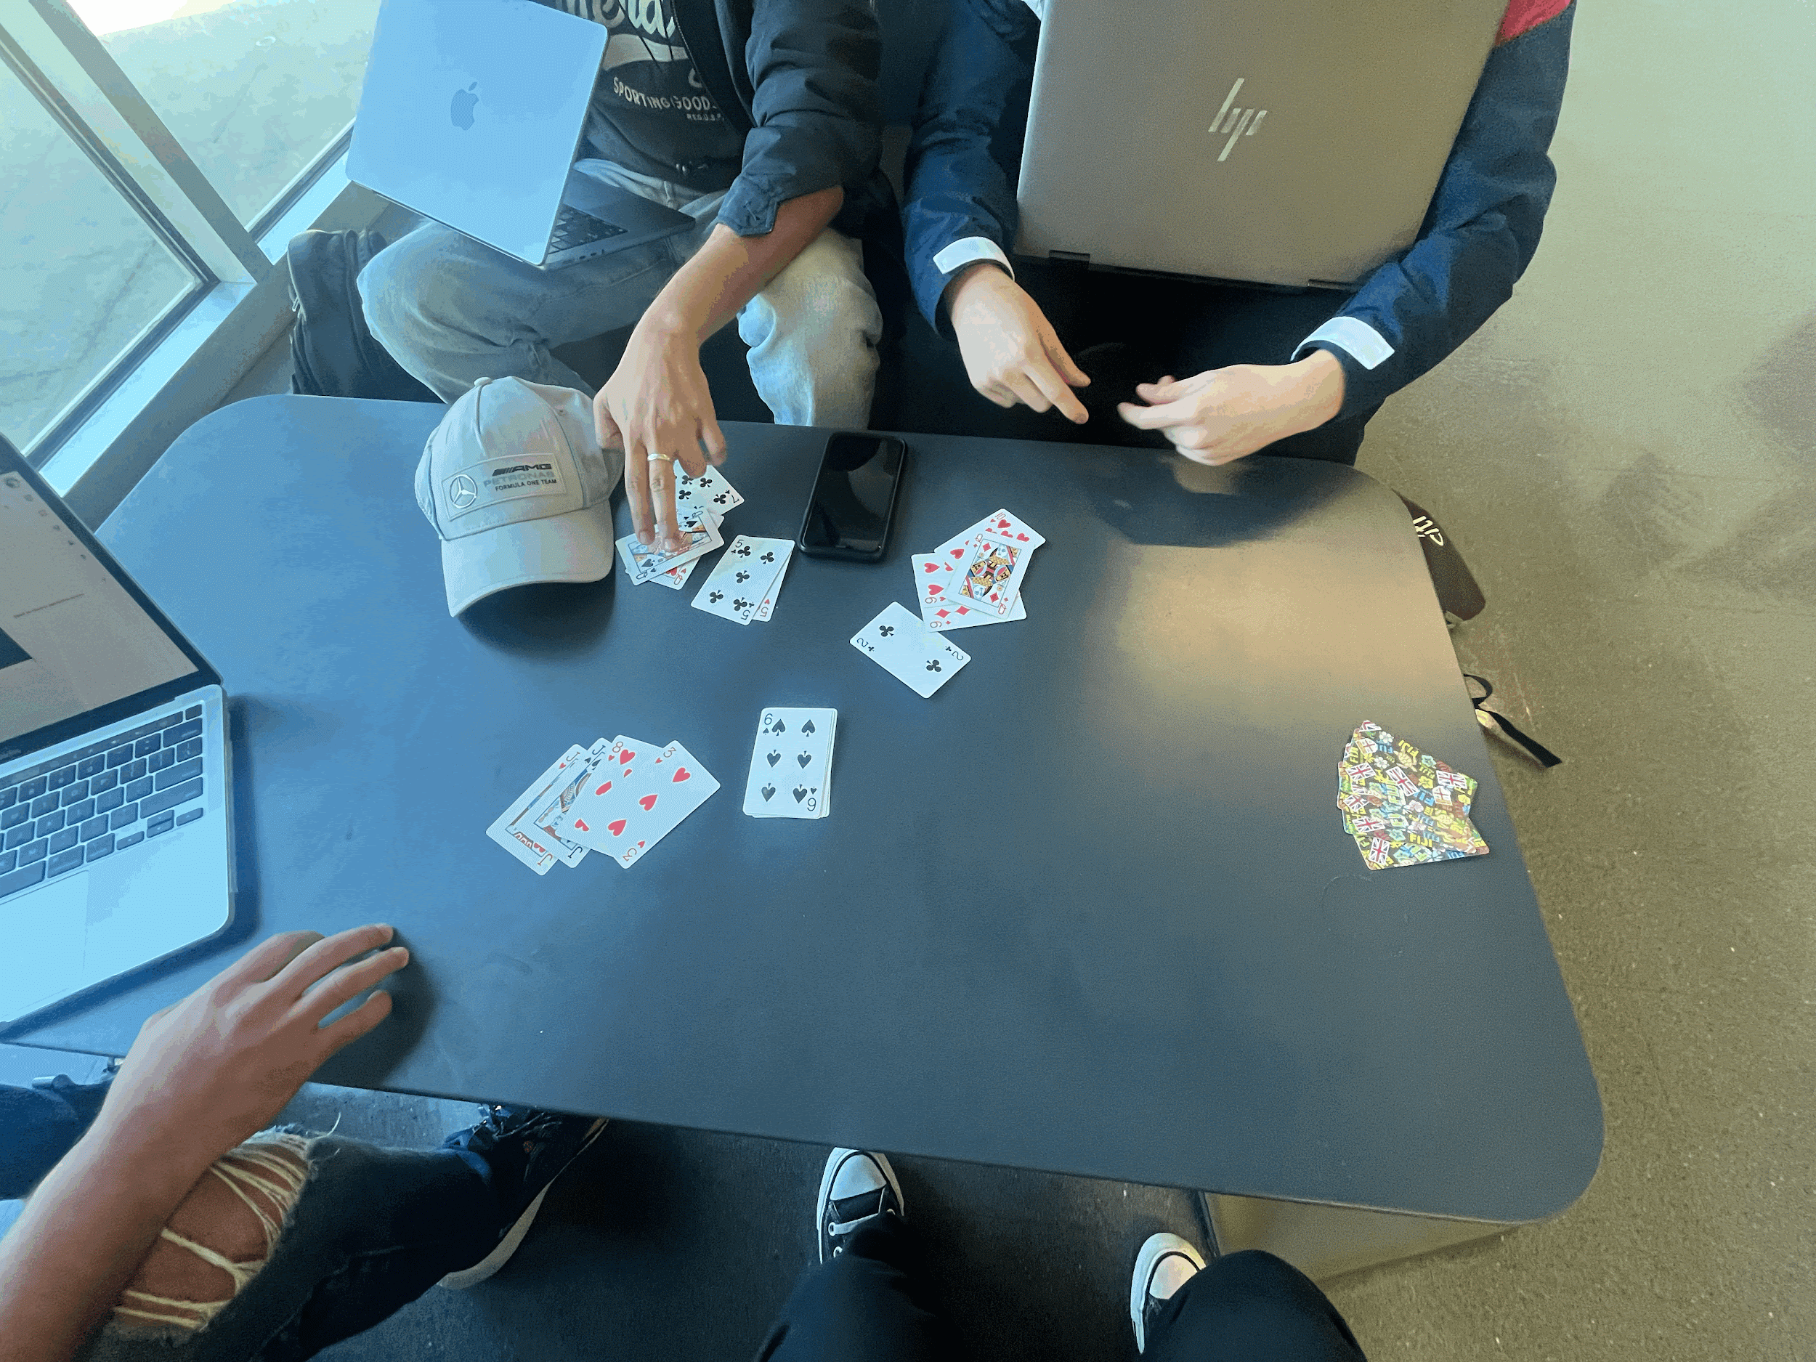
Team Building
How we foster a positive environment:
By ensuring everyone feels supportive
By not solely talking about our application (making room to talk about other things like each others hobbies/interests)

Slide 24
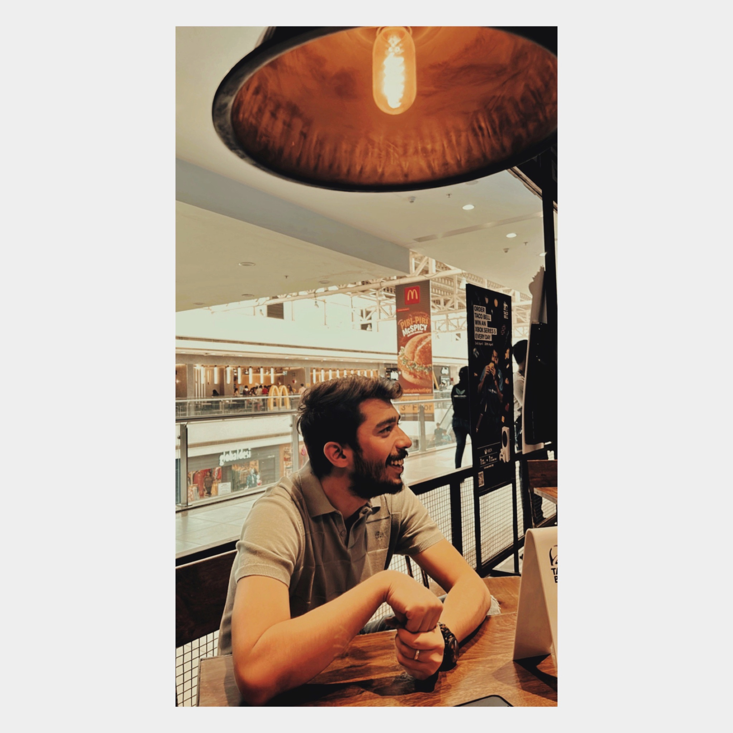
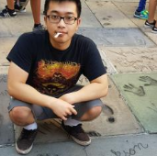
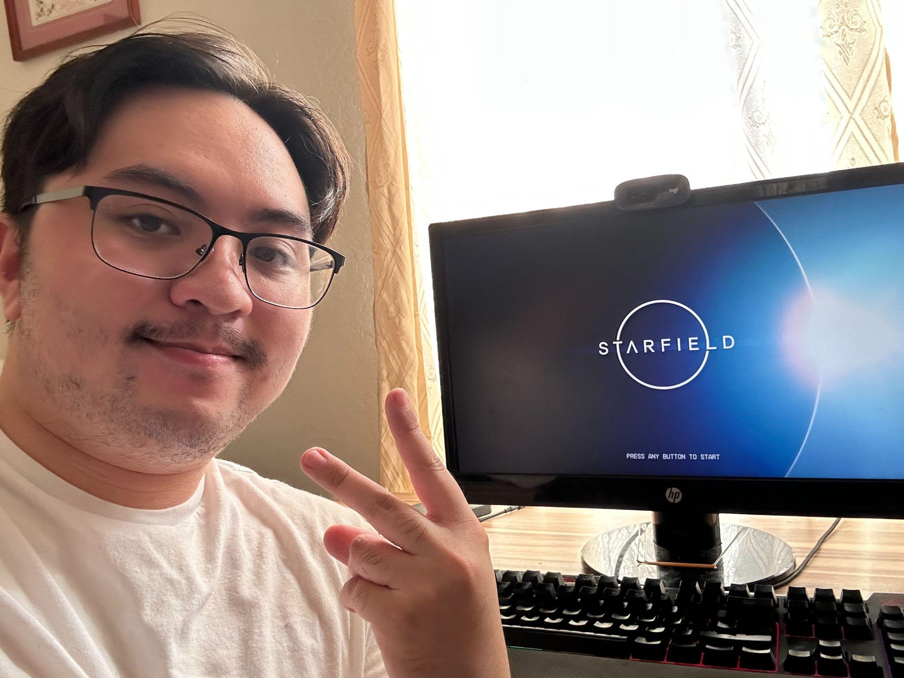
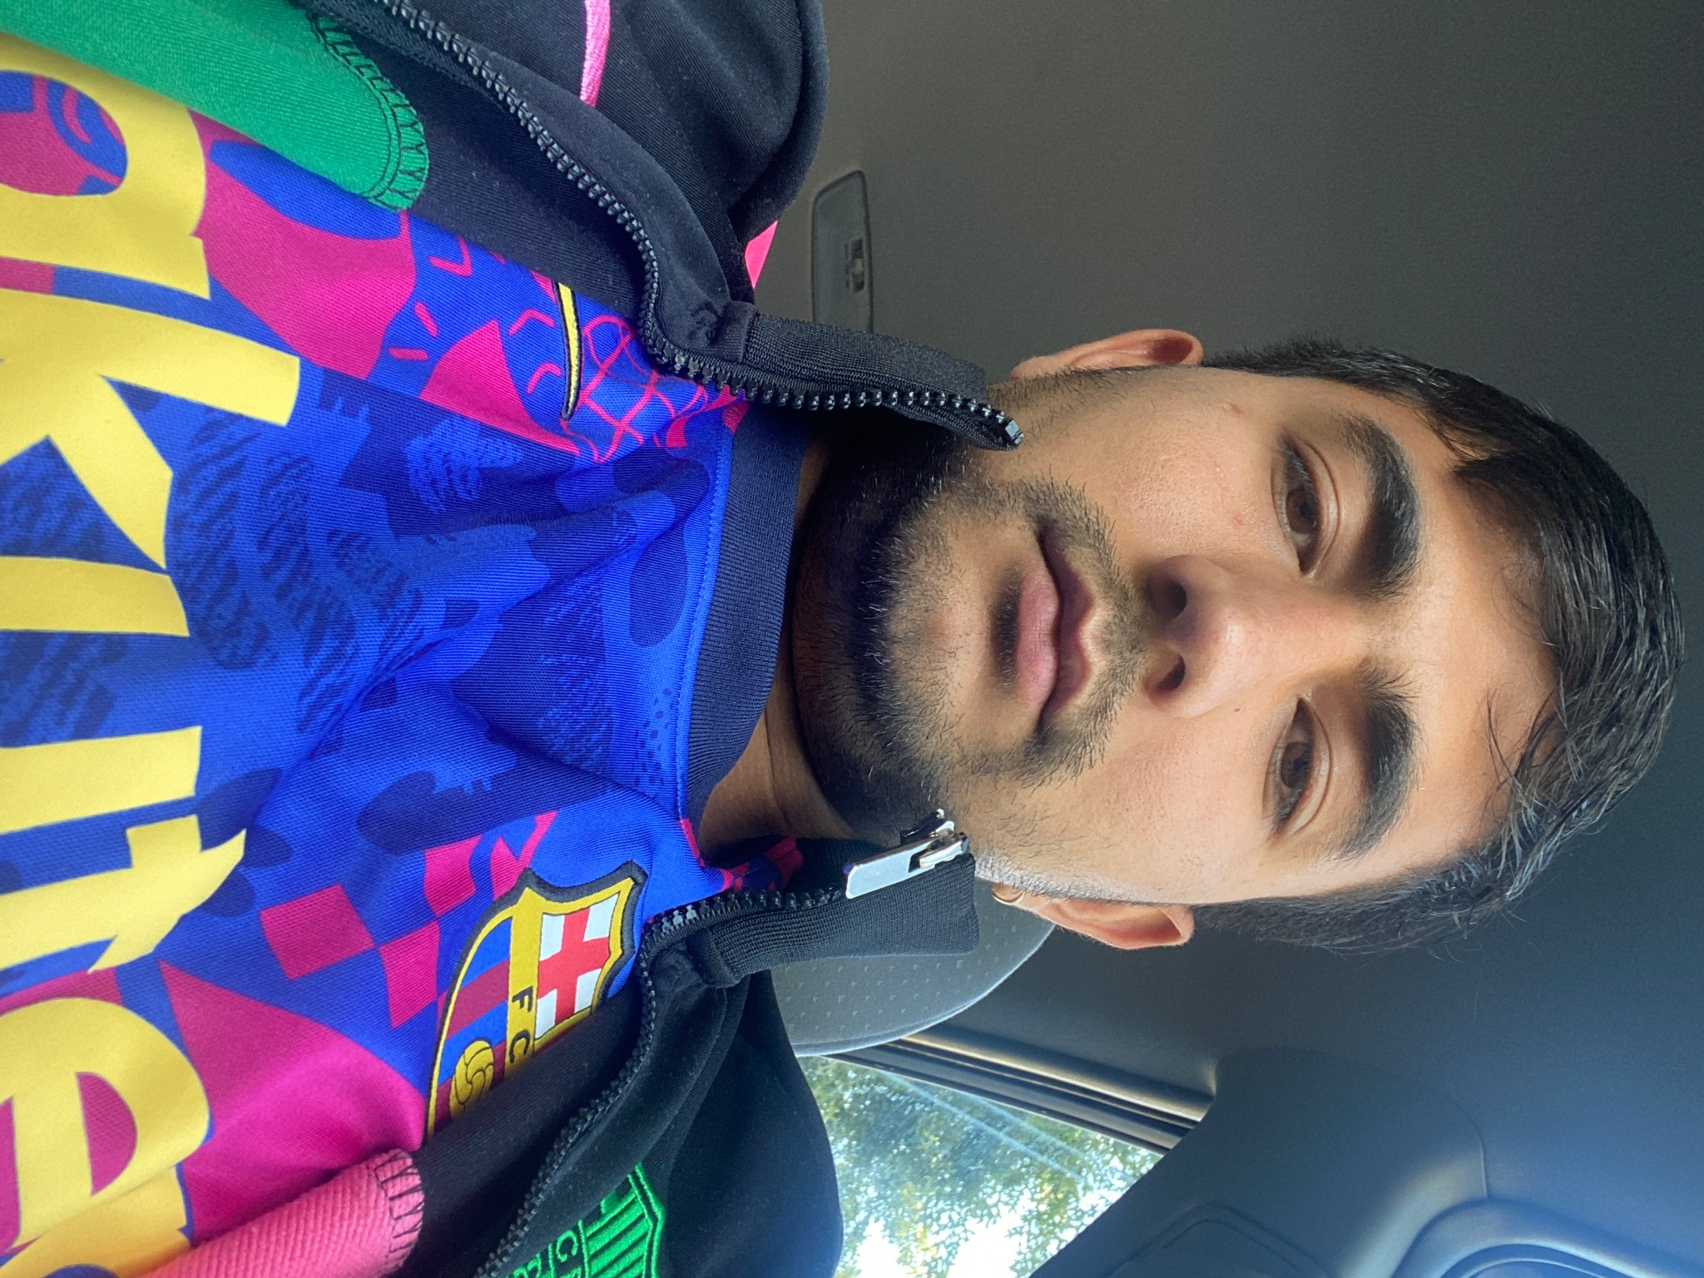
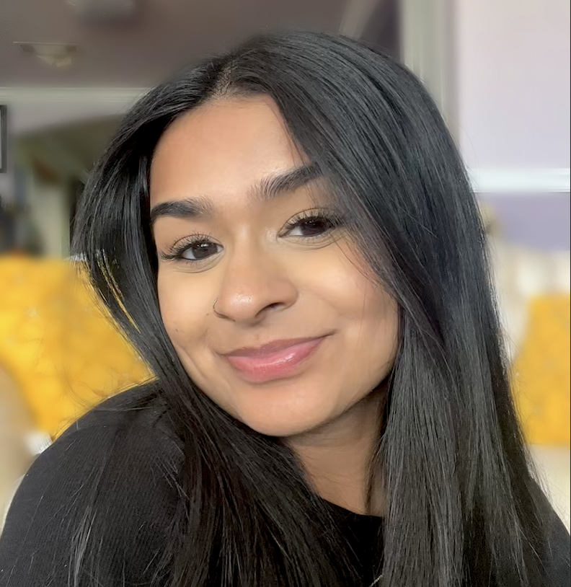
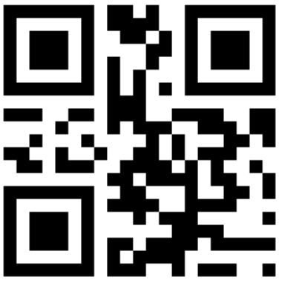
Members & Roles
Khalid Mehtab Khan Team Lead | Dat Vo Backend Lead
Jacob Perez Github Master | Anish Khadka Frontend Lead
Renee Sewak Scrum Master

